Slide 1
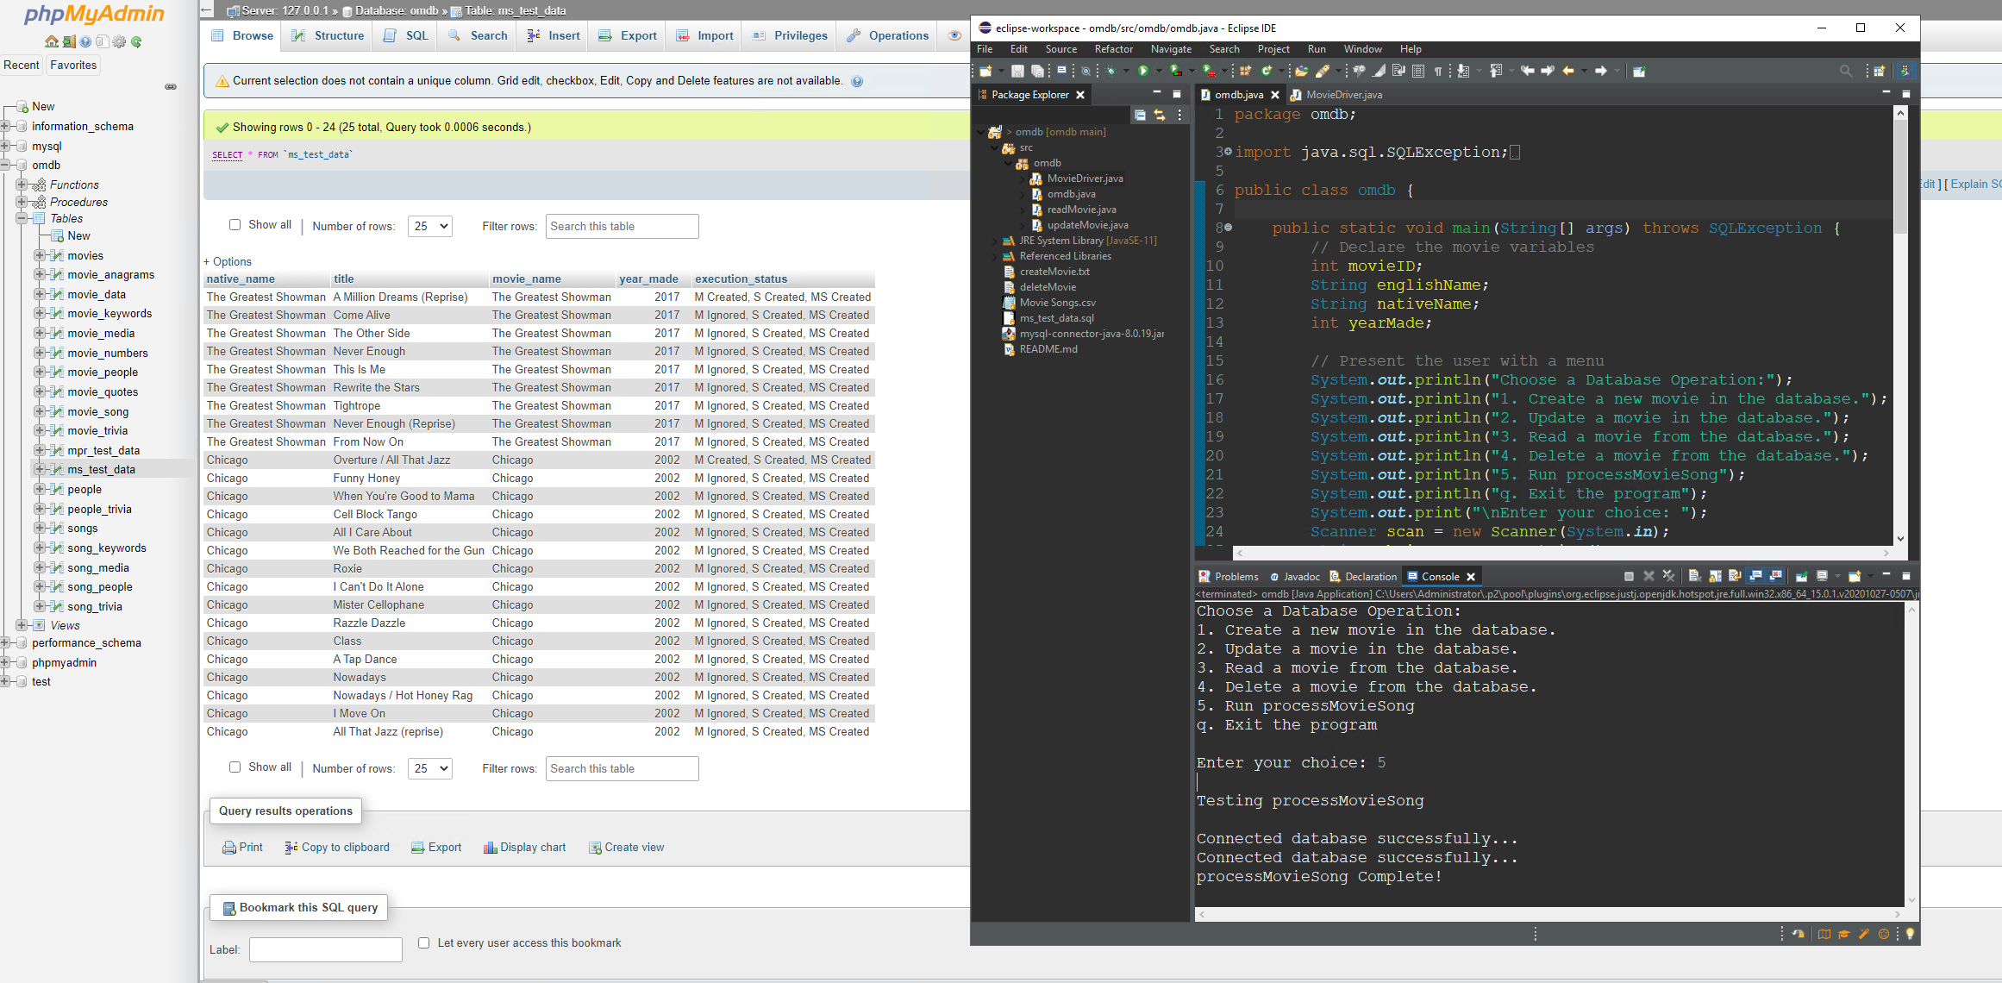
Test Case ID: 1 Test Case Title: Movie in database “ms_test_data” created.
Test Case Description: “ms_data_test” table is read for native_name and year_made, if both or one do not exist in the “movies” table then the data is entered in the “movies” table. Execution status column in “ms_data_test” updated accordingly.
Test Case Data: “ms_test_data” table is the test table for this case, it contains new data and existing data that can be found in the “movies” table.
Expected Result:
[1] The last column named “executions status” would read “M created”.
[2] All new movies in “ms_test_data” are created in "movies" database.
Actual Result: [x] Passing [ ] Failing

Slide 2
Test Case ID: 2 Test Case Title: Movie in database “ms_test_data” ignored.
Test Case Description: “ms_data_test” table is read for native_name and year_made, if both do exist in the “movies” table the system will ignore the data, “movies” table will not be updated with that data. Execution status column in “ms_data_test” updated accordingly.
Test Case Data: “ms_test_data” table is the test table for this case, it contains new data and existing data that can be found in the “movies” table.
Expected Result:
[1] The last column named “executions status” would read “M ignored”.
[2] All duplicate movies in “ms_test_data” are ignored and no new data added to "movies" table.
Actual Result: [x] Passing [ ] Failing

Slide 3
Test Case ID: 3 Test Case Title: Title in database “ms_test_data” created.
Test Case Description: “ms_data_test” table is read for “title”, if “title” does not exist in the “Songs” table then the new data is entered in the “songs” table. Execution status column in “ms_data_test” updated accordingly.
Test Case Data: “ms_test_data” table is the test table for this case, it contains new data and existing data that can be found in the “songs” table.
Expected Result:
[1] The last column named “executions status” would read “M created, S created” or “M ignored, S created”.
[2] All new songs in “ms_test_data” are created in "songs" database.
Actual Result: [x] Passing [ ] Failing

Slide 4
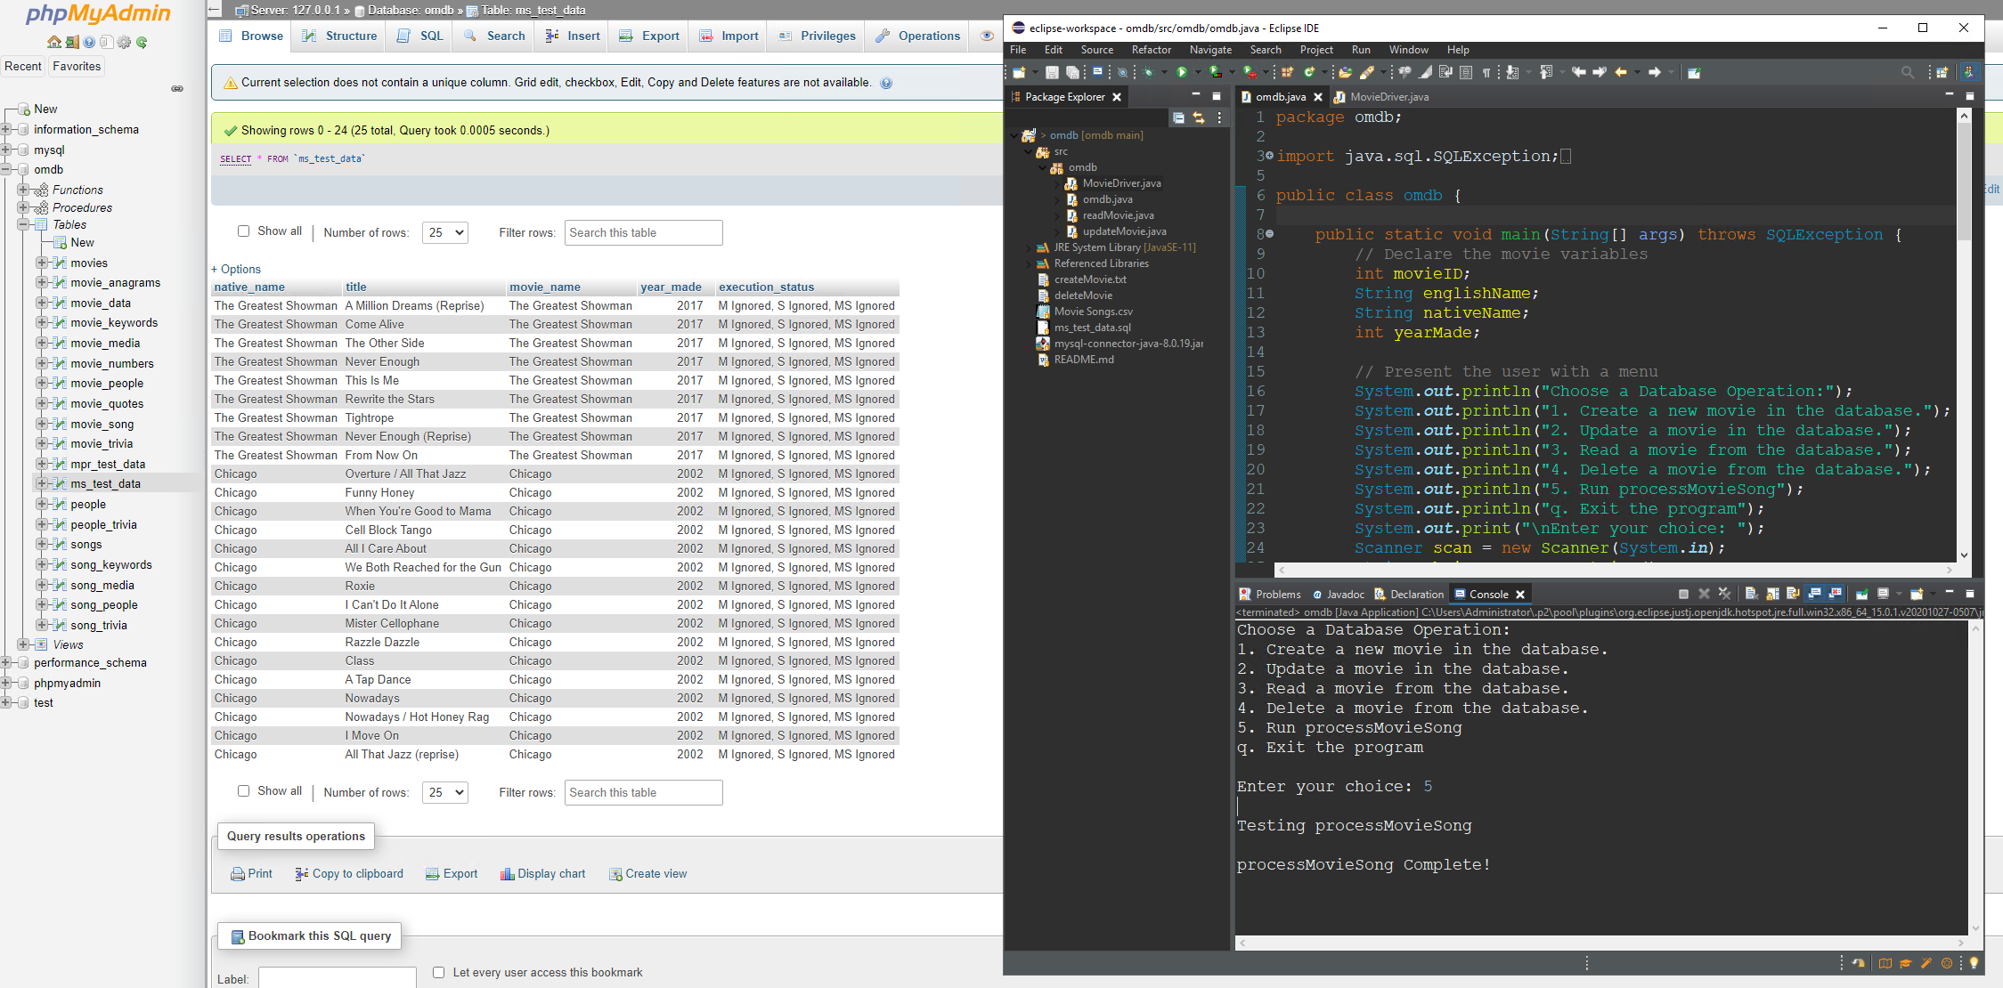
Test Case ID: 4 Test Case Title: Title in database “ms_test_data” ignored.
Test Case Description: “ms_data_test” table is read for “title”, if “title” already exists in the “songs” table the system will ignore the data, “songs” table will not be updated with that data. Execution status column in “ms_data_test” updated accordingly.
Test Case Data: “ms_test_data” table is the test table for this case, it contains new data and existing data that can be found in the “movies” table.
Expected Result:
[1] The last column named “executions status” would read “M created S ignored” or “M ignored S ignored”.
[2] All duplicate titles in “ms_test_data” are ignored and no new data added to "songs" table.
Actual Result: [x] Passing [ ] Failing

Slide 5
Test Case ID: 5 Test Case Title: Relationship created between “movie_id” and “song_id”.
Test Case Description: “movie_song” table is read to determine if a relationship already exists between the title and movie, if not the relationship is created in “movie_song” table. Execution status column in “ms_data_test” updated accordingly.
Test Case Data: “ms_test_data” table is the test table for this case, it contains new data and existing data that can be found in the “movie_song” table.
Expected Result:
[1] The last column named “executions status” would read “M created, S created, MS created” or “M ignored, S created, MS created” or “M created, S ignored, MS created”.
[2] Relationship created between “movie” and “title”, and data is created in “movie_song” to link them.
Actual Result: [x] Passing [ ] Failing

Slide 6
Test Case ID: 6 Test Case Title: Relationship ignored between “movie_id” and “song_id”.
Test Case Description: “movie_song” table is read to determine if a relationship already exists between the title and movie, if there is already a relationship created in “movie_song” table, then the request is ignored. Execution status column in “ms_data_test” updated accordingly.
Test Case Data: “ms_test_data” table is the test table for this case, it contains new data and existing data that can be found in the “movie_song” table.
Expected Result:
[1] The last column named “executions status” would read “M ignored, S ignored, MS ignored”.
[2] No new relationship is created, and no new data linked in “movie_song” table.
Actual Result: [x] Passing [ ] Failing

Slide 7
Test Case ID: 7 Test Case Title: Existing data.
Test Case Description: If data entered in “ms_test_data” is read, and all the data “movie”, “title”, “year_made”, is existing in the corresponding tables, then all entries should be ignored and the “execution status” would reflect that accordingly.
Test Case Data: “ms_test_data” table is the test table for this case.
Expected Result:
[1] The last column named “executions status” would read “M ignored, S ignored, MS ignored”.
[2] No new data entered to any of the tables on the database.
Actual Result: [x] Passing [ ] Failing

Slide 8
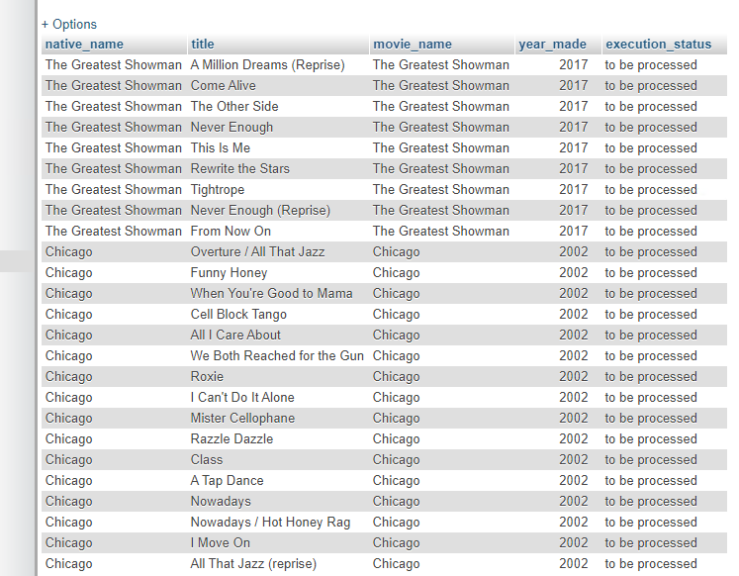
Test Case ID: 8 Test Case Title: Exceptions caught
Test Case Description: non string or number is handled by exception, exception is displayed for the user.
Test Case Data: ms_test_data” table is the test table for this case, it contains the data to be uploaded..
Expected Result:
[1] After initial read the omdb would error and throw the appropriate exception.
[2] you are asked to “Please fix information with appropriate data before running.”
Actual Result: [x] Passing [ ] Failing

